Slide 1



NoSQL
www.thecads.com

Slide 2



Relational Database Management System (RDBMS) allows user to interact with relational databases.
Most commercial RDBMS use SQL to access the
databases.
Example of RDBMS functions:
Create
Read
Update
Delete
*collectively known as CRUD

Slide 3
Sparse data
Query speed is
Designed to run on
Not everything fits
problem
slow
a single server
well into rows and
columns
This happens when
Join information and
Consider the case of
For example: semi-
few records have
add constraints across
Big Data: Largest
structured data such
values in a column,
tables at query time,
available single
as JSON and XML
whereas other
hence the database
server couldn’t even
documents
records have null
engine has to evaluate
store or process all
values in that
many tables.
the Big Data.
columns.

Slide 4


NoSQL coined in 1998 to name a relational database that did not have a SQL (Structured Query Language) interface, i.e. Not Only SQL.
Brought back in 2009 during a meetup about
distributed database.

Slide 5
Schema Agnostic
Commodity
Hardware
Non Relational
Highly Distributed

Slide 6
Schema Agnostic
A schema is not required in NoSQL, hence provide the freedom to store data without designing any up-front schema design.

Slide 7
Non-Relational
Data is stored as an aggregate in NoSQL, in which an information could be duplicated in different rows that use the information.

Slide 8
Commodity Hardware
NoSQL can perform well with cheap off‐the‐shelf servers. In fact, it adds scalability to NoSQL databases by adding more of these cheap servers.

Slide 9
Highly Distributed
A cluster of servers can be used as a single large database server. NoSQL allows the servers to talk to each other to handle the distributed queries.

Slide 10

NoSQL loses the support for ACID principles as trade- off for increased scalability and availability.
NoSQL systems is inherently bound to the CAP Theorem.

Slide 11
WHAT IS ACID?
WHAT IS CAP?
Atomicity: Each operation affects the specified data, and no other data, in the database.
Consistency: Each operation moves the database from one consistent state to another.
Isolation: One operation in-flight does not affect the others.
Durability: The database will not lose
your data once the transaction reports
success.
Consistency: Data is the same for all parts of the cluster eventually.
Availability: Data is still available after
Partition-Tolerance: Database is still able to function if some parts of the cluster are not communicating with each other and will correct itself when communication is
partitioning.
restored.

Slide 12

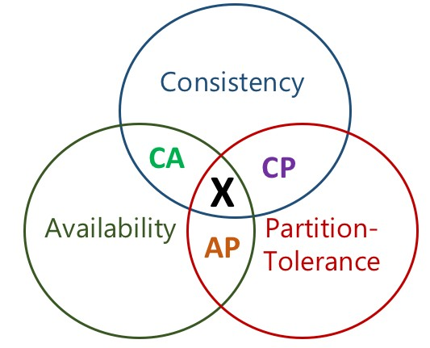
Described the trade-offs involved in distributed system.
CAP theorem states that a distributed system cannot
have all three features at the same time..

Slide 13
Consistency & Availability
CA
Some NoSQL databases provide consistency by adding read-only replicas of data on additional nodes.
Advantage:
Improve read performance
Provide greater availability (at least for read, not write)

Slide 14
Availability & Partition-Tolerance
AP
Some NoSQL databases ensure the nodes in the cluster remain online even if they are unable to communicate with each other.
As restoration step, data would be synchronized once the partition is resolved (However, the consistency of data is not guaranteed either during or after the partition).

Slide 15
Consistency & Partition-Tolerance
CP
Some NoSQL databases maintain the consistency of data from all nodes and preserve the partition- tolerance by making data unavailable when a node goes down.

Slide 16
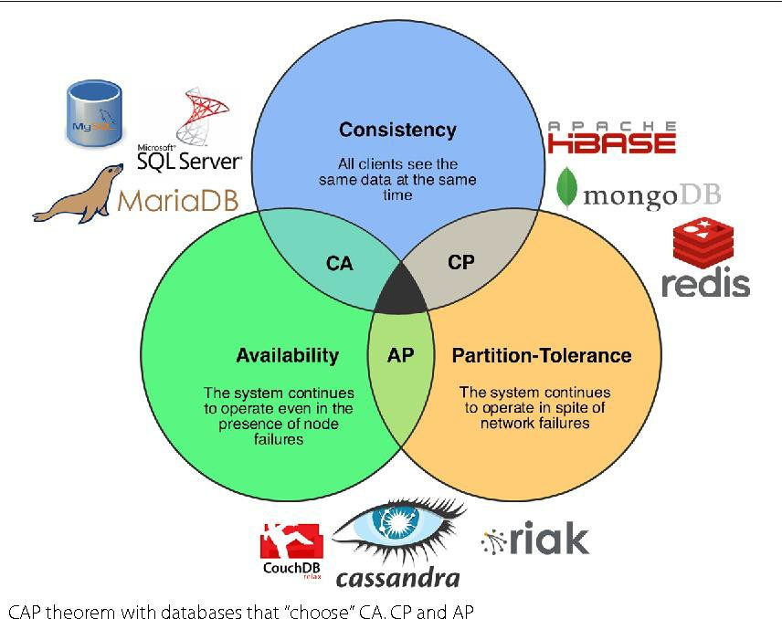
EXAMPLES OF
DATABASE IN DIFFERENCE COMBINATION OF CAP
Source: https://www.semanticscholar.org/paper/Choosing-the-right-NoSQL-
database-for-the-job%3A-a-Louren%C3%A7o- Cabral/1371cf364fddbf01f3e404fca203cad5e49cec9a
Copyright © 2019 CADS and/or its affiliates. All rights reserved. CADS Confidential – Internal/Restricted/Highly Restricted

Slide 17
CAP Theorem is not “binary” decision. For example:
AP systems focus on offering Availability and Partitioning – but are not inconsistent in some extent.
CP systems focus on Consistency and Partitioning - but are not
unavailable in some extent.
Hence, CAP Theorem offers certain degree in tolerating the Consistency, and Availability, as well as Partition-Tolerance.
Copyright © 2019 CADS and/or its affiliates. All rights reserved. CADS Confidential – Internal/Restricted/Highly Restricted

Slide 18

“Most people who choose NoSQL as their primary data storage are trying to solve two main problems: scalability and simplifying the development process,” said Danil Zburivsky, solutions archit_{w}e_{ww}c_{.t}t_{hec}a_{ad}t_{s.c}P_{om}ythian
Source: https://sdtimes.com/big-data/number-of-nosql-options-grow

Slide 19
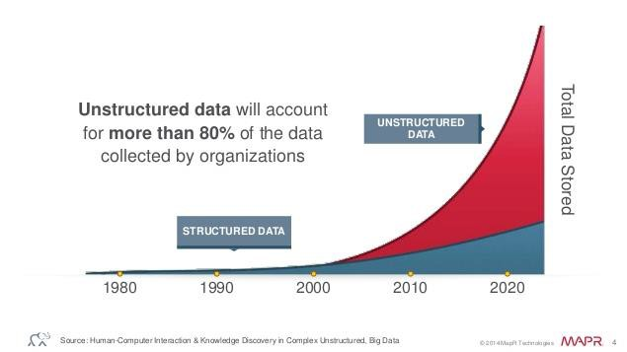
1
NoSQL Databases ease _{un} the storage of
structured data due to
the feature of Schema Agnostic
Source: https://www.huffingtonpost.com/sriram-krishnan2/ex-summly-team-
Copyright © 2019 CADS and/or its affiliates. All rights reserved. CADS Confidential – Internal/Restricted/Highly Restricted
launches-c_b_9412276.html

Slide 20

2
NoSQL Databases can store and process Big Data in real time

Slide 21

3
NoSQL Databases ease the scalability of handling the volume of Big Data
(Horiz

Slide 22





Graph database are used to store all the contacts
and keywords of Gmail account.
Google built Bigtable and use it to store data of few
INDUSTRY:
Internet-Related Services
applications such as Google Earth, Google Finance, and
web indexing
USE CASE:
Specialized Storage for Unstructured Data

Slide 23

Although schema is not required in NoSQL, there may be an issue of using bad assumptions of data and without structure planning properly. Hence, data modelling is still necessa_{w}r_{ww.t}y _{h}f_{ec}o_{ad}r_{s.c}N_{om}oSQL.

Slide 24

Two Ways of Performing Data Modeling:
Mind Map
JSON Notation

Slide 25

Mind map is a diagram to represent ideas visually.
It allows users to sort through different details and establish relationships among the details easily.
In NoSQL, it helps to determine the structure of databases.

Slide 26
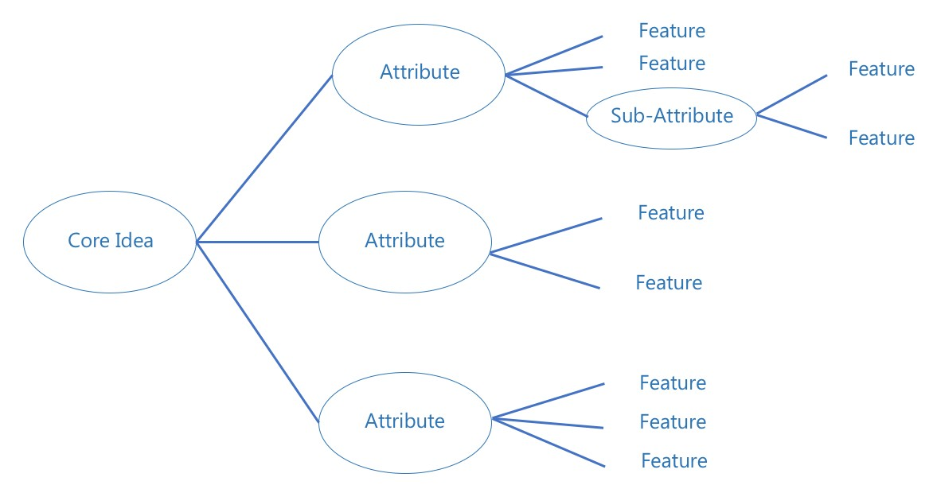

Slide 27
Case Study: Customer 360 View
An online shopping system would like to aggregate customer profiles with NoSQL database. They hire you to be the developer to design and employ the NoSQL database.
The company will provide the html web interfaces and you have to store all the entries or data in the database. In general, they would like to create a database that stores customer- centric data, and the data are mostly collected from customer information, order, and payment information.

Slide 28
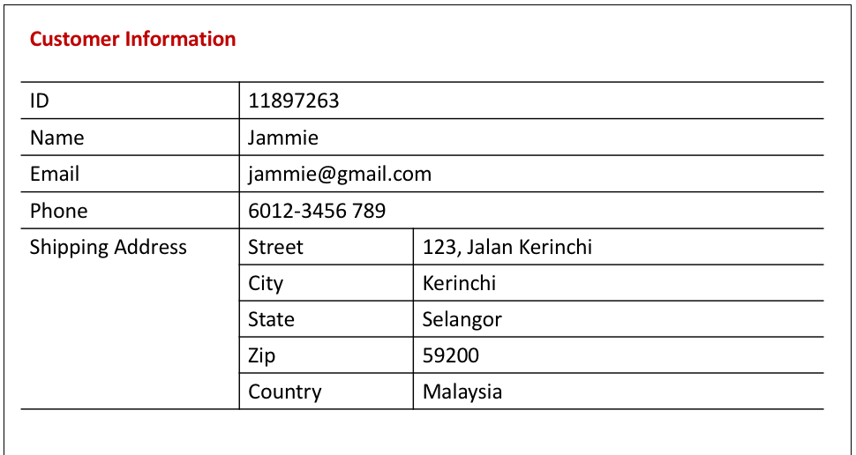
Case Study: Customer 360 View

Slide 29
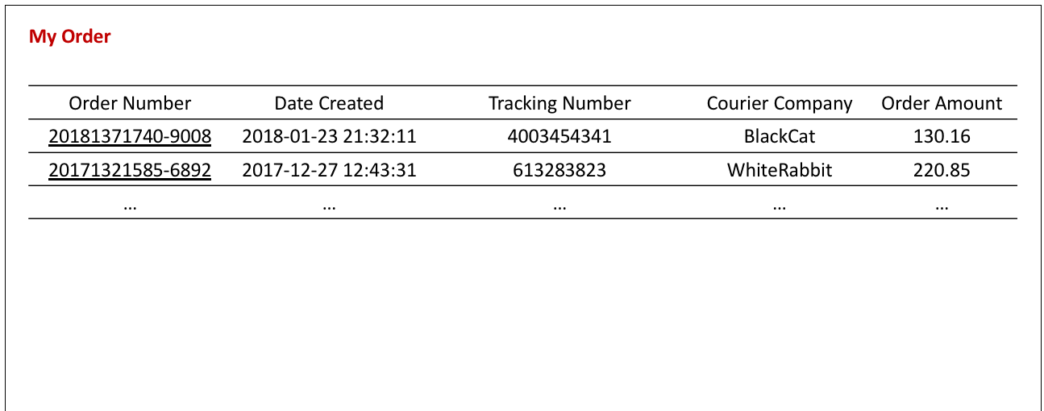
Case Study: Customer 360 View

Slide 30



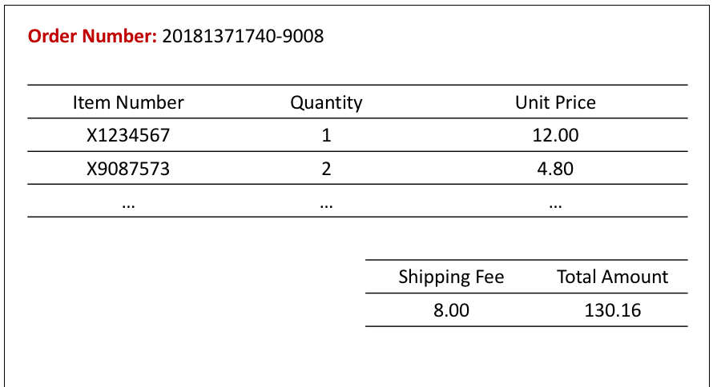
Case Study: Customer 360 View

Slide 31
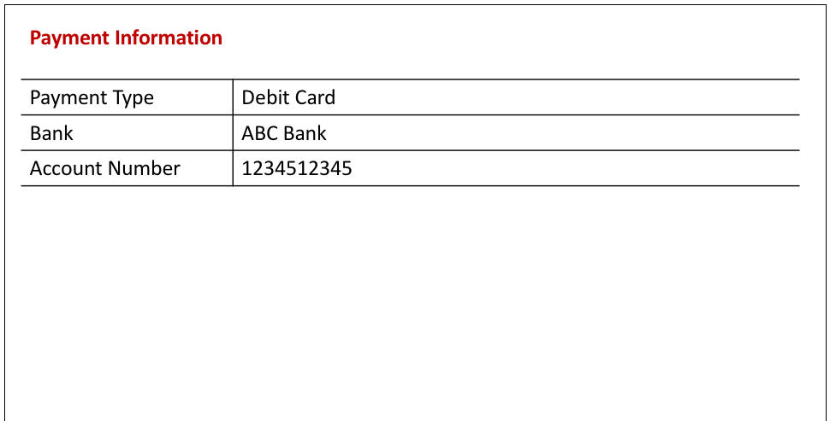
Case Study: Customer 360 View

Slide 32
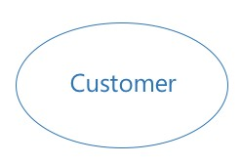
Case Study: Customer 360 View
STEP 1: Define the core idea/ business need

Slide 33
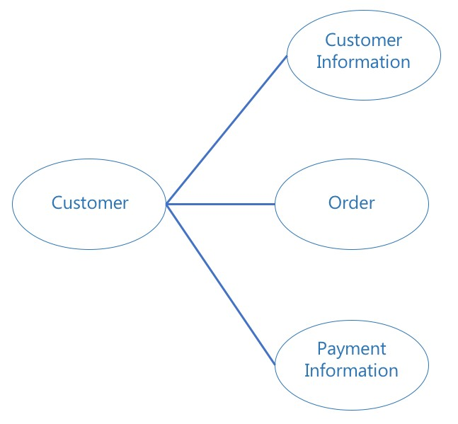
Case Study: Customer 360 View
STEP 2: Define the attributes that describe the core idea
Clue: In general, they would like to create a database that stores customer-centric data, and the data are mostly collected from customer information, order, and payment information.

Slide 34
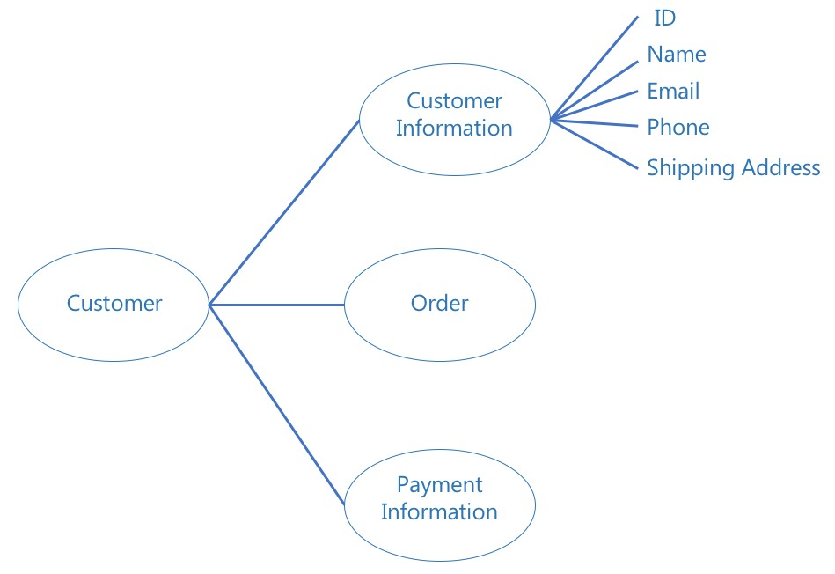
Case Study: Customer 360 View
STEP 3: Define the sub-attributes/features for each attribute
Something Wrong?

Slide 35
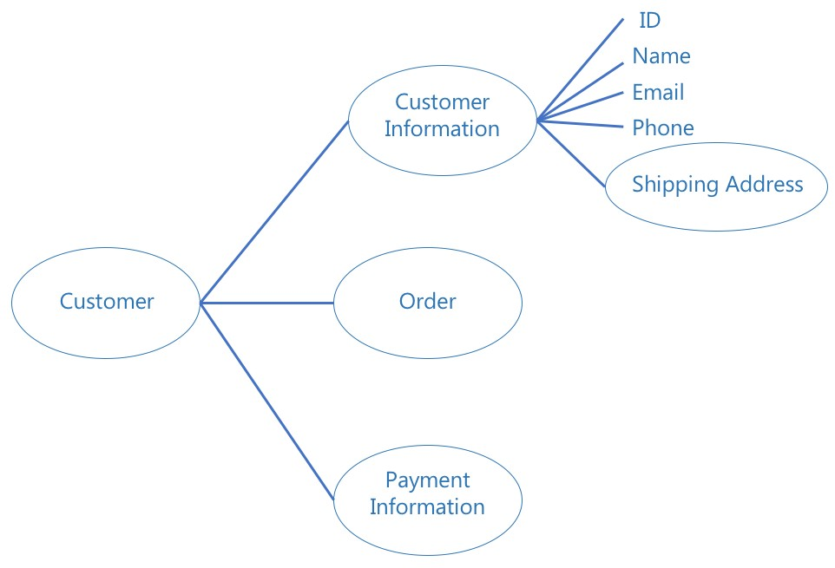
Case Study: Customer 360 View
STEP 3: Define the sub-attributes/features for each attribute

Slide 36
Case Study: Customer 360 View
What Next?

Slide 37
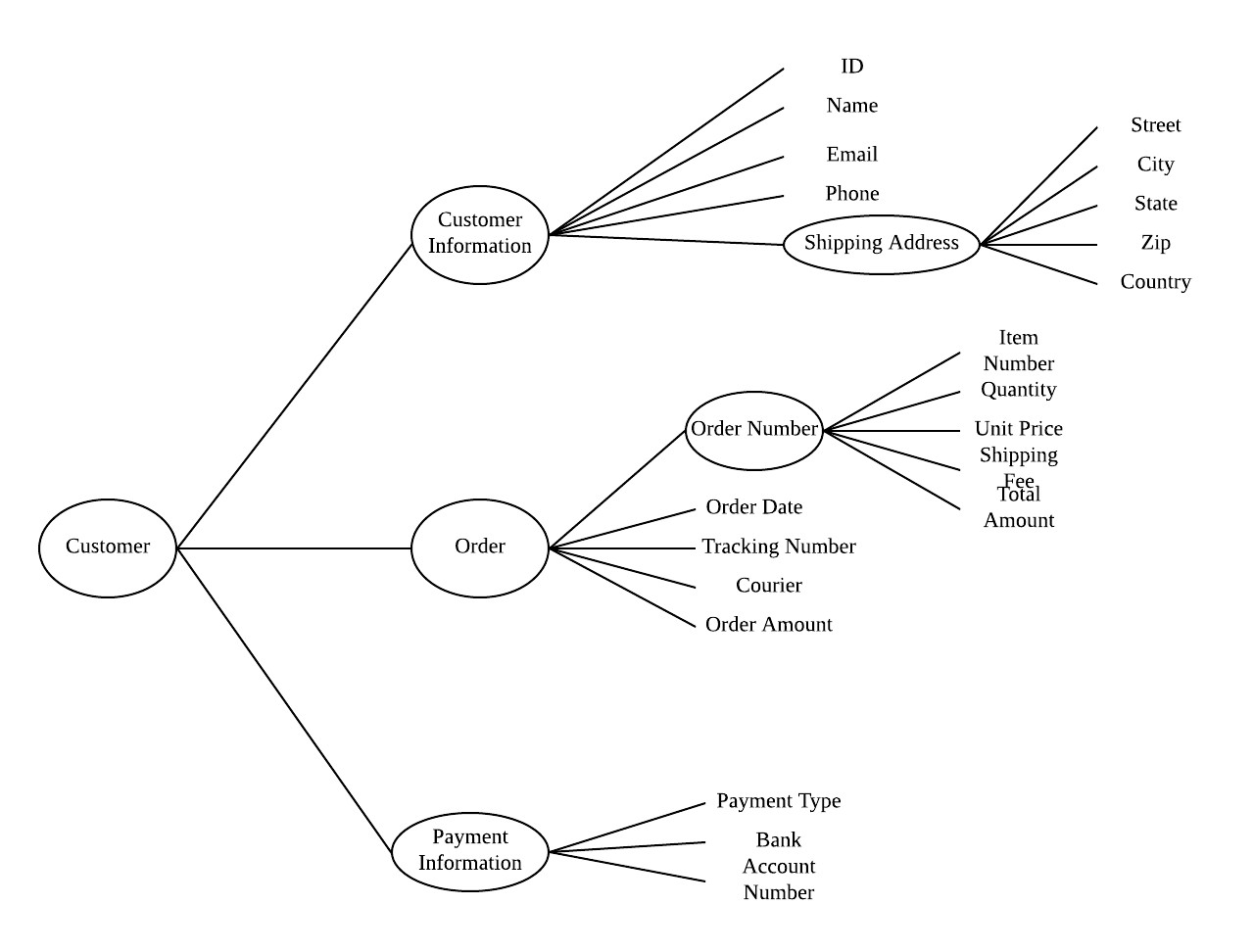
Case Study: Customer 360 View
*Created with Lucidchart

Slide 38
Case Study: Customer 360 View
{
"employees": {
"employee": [
{
"id": "1",
"firstName": "Tom", "lastName": "Cruise",
"photo": "https://jsonformatter.org/img/tom-cruise.jpg"
},
{
"id": "2",
"firstName": "Maria", "lastName": "Sharapova",
"photo": "https://jsonformatter.org/img/Maria-Sharapova.jpg"
} ]
JSON is a tagged language and is used to
describe the instances.
It is a text-based method to define the
structure of a NoSQL database.
}
Copyright © 2019 CADS and/or its affiliates. All rights reserved. CADS Confidential – Internal/Restricted/Highly Restricted
}

Slide 39
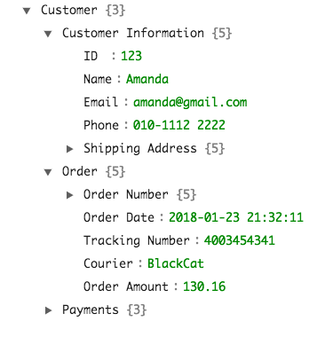
Case Study: Customer 360 View
Copyright © 2019 CADS and/or its affiliates. All rights reserved. CADS Confidential – Internal/Restricted/Highly Restricted
*Created with JSON Formatter

Slide 40
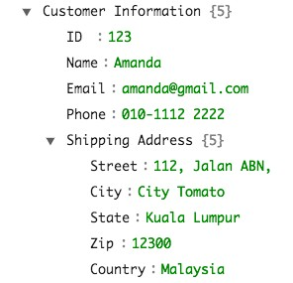
Case Study: Customer 360 View

Slide 41
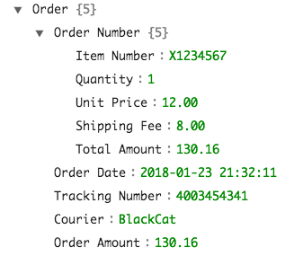
Case Study: Customer 360 View

Slide 42
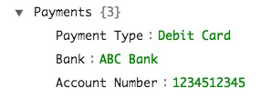
Case Study: Customer 360 View

Slide 43
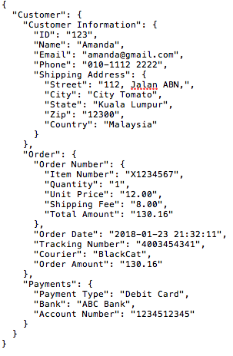
Case Study: Customer 360 View

Slide 44
Key-Value Store
Document-Based
Graph-Based
Wide Column
Store
Document-Based

Slide 45
Key-Value Store

Slide 46


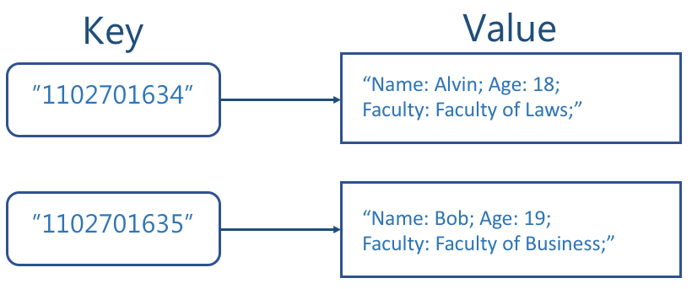
Data is stored as a collection of key-value pairs.
Maps are the simplest module in key-value store. A unique key in map has a single value associated with it.
Sometimes, the value could be a list of another map. So, user is able to create tree- structures within key-value store.
Key‐value stores are optimized for speed of
ingestion and retrieval.

Slide 47


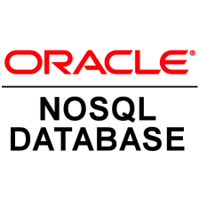
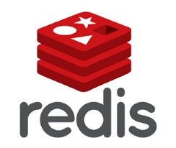


Slide 48
USE CASE
Manage transient information
Handle high‐speed retrieval
1
Mission‐critical data.
The ability to scale up for user supporting data.
Manage User
Information

Slide 49
USE CASE
Manage transient information
Handle high‐speed retrieval
2
Speed is crucial so that the advertisements do
not slow down the user’s experience.
The key can be served as the combination of factors that determine what a user interested, whereas the value stores every thing that is required to serve the advertisement.
Deliver Web
Ad

Slide 50
USE CASE
Manage transient information
Handle high‐speed retrieval
3
Websites may need to store various types of
short-lived session data.
Key‐value stores
are ideal to store and
retrieve session data at high speeds.
Handle User
Sessions

Slide 51


Industrial Example
Facebook uses Memcache as the distributed key-value
INDUSTRY:
Social Networking Services
store to improve users experience by caching the data
requested by clients for further requests.
USE CASE:
Near Real-Time Personalization

Slide 52
Document-Based

Slide 53

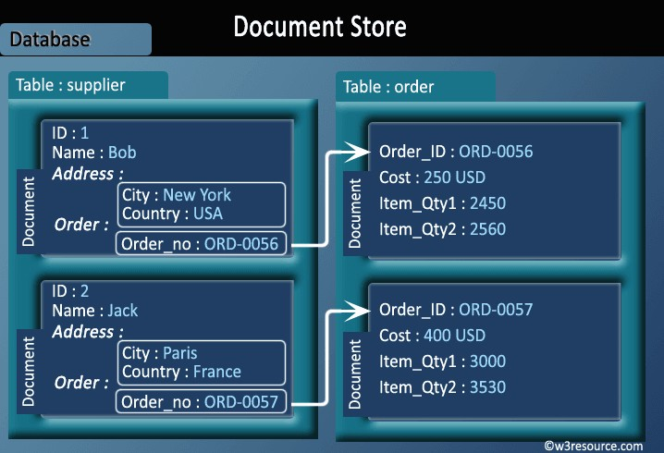
A.k.a aggregate database because it stores documents in single logical unit (an aggregate).
Generally, a document is any unstructured or semi-structured piece of data.
The value of a document can be retrieved
by a key.
Source: https://www.w3resource.com/mongodb/nosql.php

Slide 54




Slide 55
USE CASE
Modify data structures
Control unstructured data feeds
1
It is useful to store the document lifecycle
status.
These information are usually kept as XML schema.
*Content Processing Framework (CPF) of
Manage
MarkLogic Server
Content Lifecycle

Slide 56
USE CASE
Modify data structures
Control unstructured data feeds
2
Organizations can collect data from various
departments and public data.
However, these ever-changing data may
appear in different formats.
Document-based database is suitable to
Manage Changing
handle these varieties.
Data Structures

Slide 57
USE CASE
Modify data structures
Control unstructured data feeds
3
Document-based datasets is suitable to store
data related to the same topic.
Some document-based databases can add
documents to multiple collections.
Consolidate
Related Data

Slide 58

Industrial Example
TuneWiki enhance the user music experience by allowing them to share their favourite photos, music, and lyrics with friends.
INDUSTRY:
Music Applications
TuneWiki adopts Couchbase as a replacement for
Memcached to cache and store everything the
application needs such as the photos, lyrics, timelines,
USE CASE:
Near Real-Time Personalization
and API keys.

Slide 59
Graph-Based

Slide 60
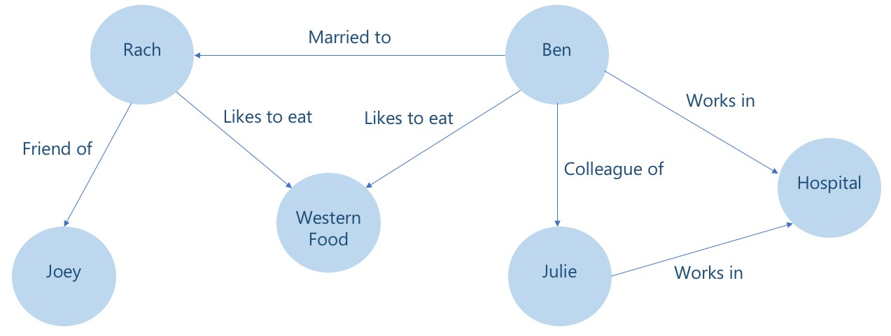
Designed for data which consists of interconnected elements and well defined relations.
Every assertion is represented as vertices and edge.
Vertex is the thing described, could be physical object (eg: a person) or a concept (eg: meeting).
Edge is the relationship in the graph.

Slide 61





Slide 62
USE CASE
Handle unstructured information
Establish social relationships
1
The relationships between words, phrases,
and sentences could be stored with graph-
based database.
Inferencing could be performed with graph- based database.
Store Semantic
Facts from Text

Slide 63
USE CASE
Handle unstructured information
Establish social relationships
2
As an example, the possible provenance tracking could be to find collusion in financial markets to trace the pattern of fraud.
Track
Pro

Slide 64
USE CASE
Handle unstructured information
Establish social relationships
3
Establishment of social networks as well as
professional organizations.
Manage

Slide 65

Industrial Example
TalentNet is a social recommendations application to
help users to establish professional field networks.
INDUSTRY:
Social Recommendations Application
TalentNet uses graph database to store the data related to users’ companies, projects and interests/skills.
USE CASE:
Establish Connections between Users

Slide 66
Wide Column Store

Slide 67
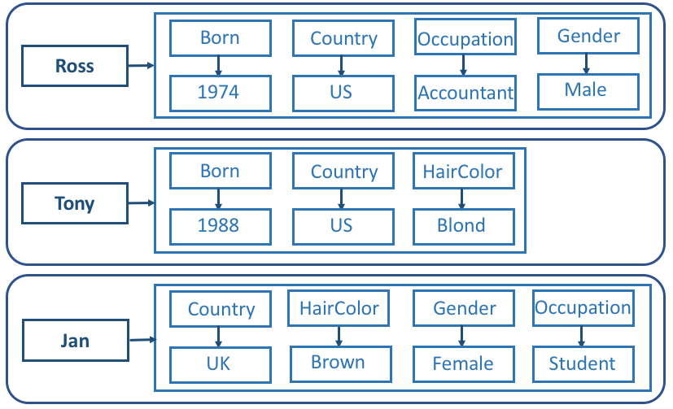
Column Keys
^{Row} Row Key
Can be seen as a two-dimensional key-
The column names and row keys are not
The names and format of columns can vary from different rows in the same table, and the columns can be added to any row at any time without having to add it to other
value store.
fixed.
rows.
Copyright © 2019 CADS and/or its affiliates. All rights reserved_{C}. CA_{o}DS _{l}C_{u}onfid_{m}ential _{n}– Inter_{V}nal/R_{a}est_{l}ric_{u}ted/_{e}Hig_{s}hly Restricted

Slide 68



Google BigTable

Slide 69
USE CASE
Restructure data to be stored in columns
Store data for later analysis
1
Wide Column Store is suitable to store sparse
data.
For example, the data related to a social media site where there are users do not provide their profile photos.
Handle

Slide 70
USE CASE
Restructure data to be stored in columns
Store data for later analysis
2
Wide Column Store can handle flexible
columns.
The same data can be stored in alternative structures at the same time. It is relatively useful to build a quick picture of a day in 5 minutes, 1-hour, or 1-day.
Store
Lo

Slide 71

Industrial Example
Instagram uses Cassandra to store auditing information related to security and site integrity
INDUSTRY:
Social Networking Application
purposes.
USE CASE:
More Affordable Scalable Storage

Slide 72
Key-value store is the simplest to implement. It is suitable for those data that is fairly static and require high-speed retrieval.
Document-based is generally having all the benefits from key-value stores, and providing the ease of data processing.
Graph-based can be used to store data that involves complex mappings.
Wide column store can be used for data reporting usage.

Slide 73

https://searchdatamanagement.techtarget.com/definition/relational-database
https://stackoverflow.com/questions/12346326/cap-theorem-availability-and-partition- tolerance
https://www.dezyre.com/article/nosql-vs-sql-4-reasons-why-nosql-is-better-for-big-data- applications/86
https://studio3t.com/whats-new/nosql-database-types/
https://www.quora.com/What-are-the-main-differences-between-the-four-types-of-NoSql- databases-KeyValue-Store-Column-Oriented-Store-Document-Oriented-Graph-Database
https://mindmapsunleashed.com/the-mind-mapping-concept-and-how-you-benefit-from-this
https://www.zdnet.com/article/look-at-what-google-and-amazon-are-doing-with-databases- thats-your-future/
https://stackoverflow.com/questions/362956/what-database-does-google-use
https://dzone.com/articles/couchbase-nosql-tunewiki
http://bitnine.net/blog-graph-database/graph-database-real-world-examples/
https://medium.com/@shagun/scaling-memcache-at-facebook-1ba77d71c082
Scaling Memcache at Facebook
https://www.datastax.com/dev/blog/facebooks-instagram-making-the-switch-to-cassandra-
from-redis-a-75-insta-savings

Slide 74






